Slide 1
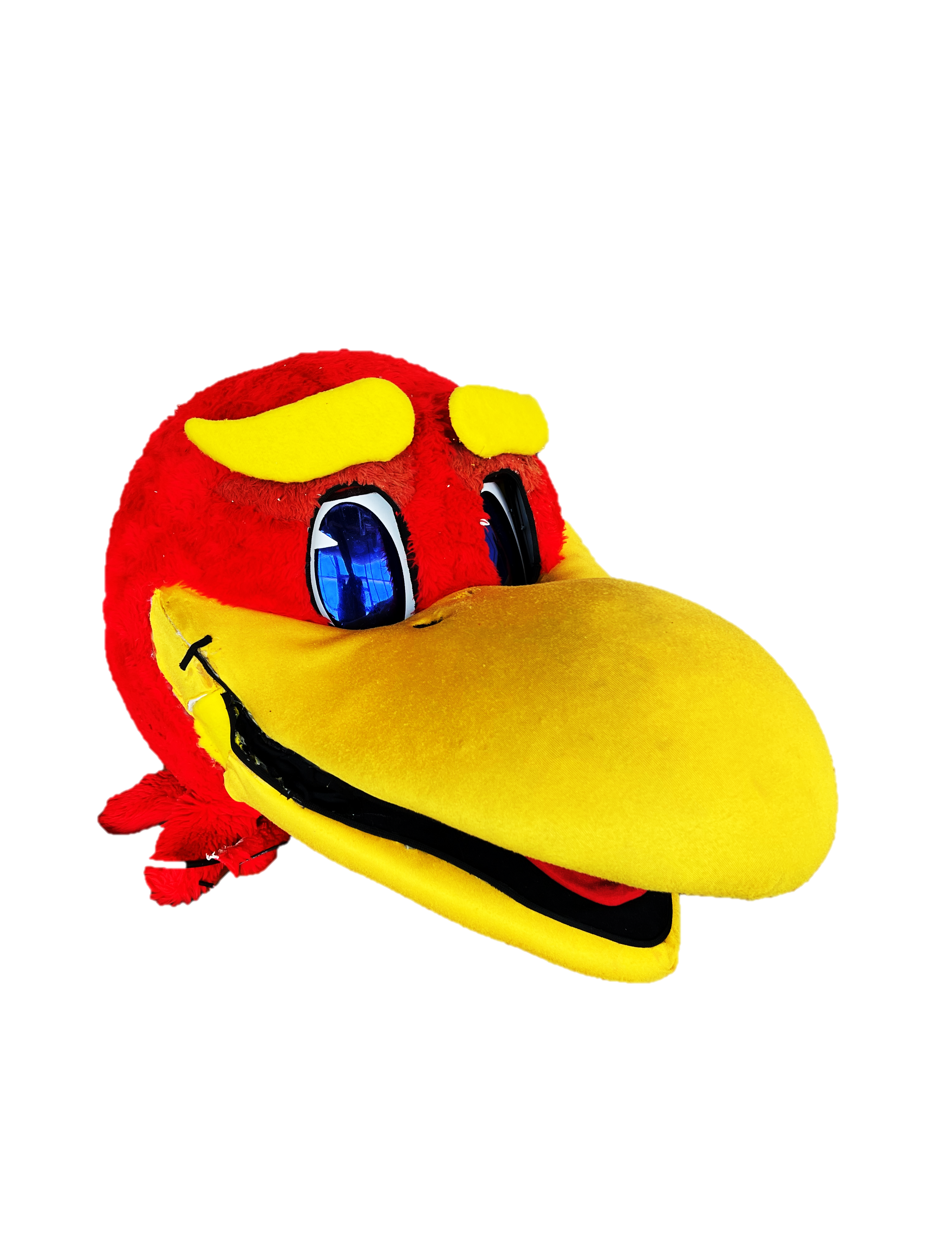
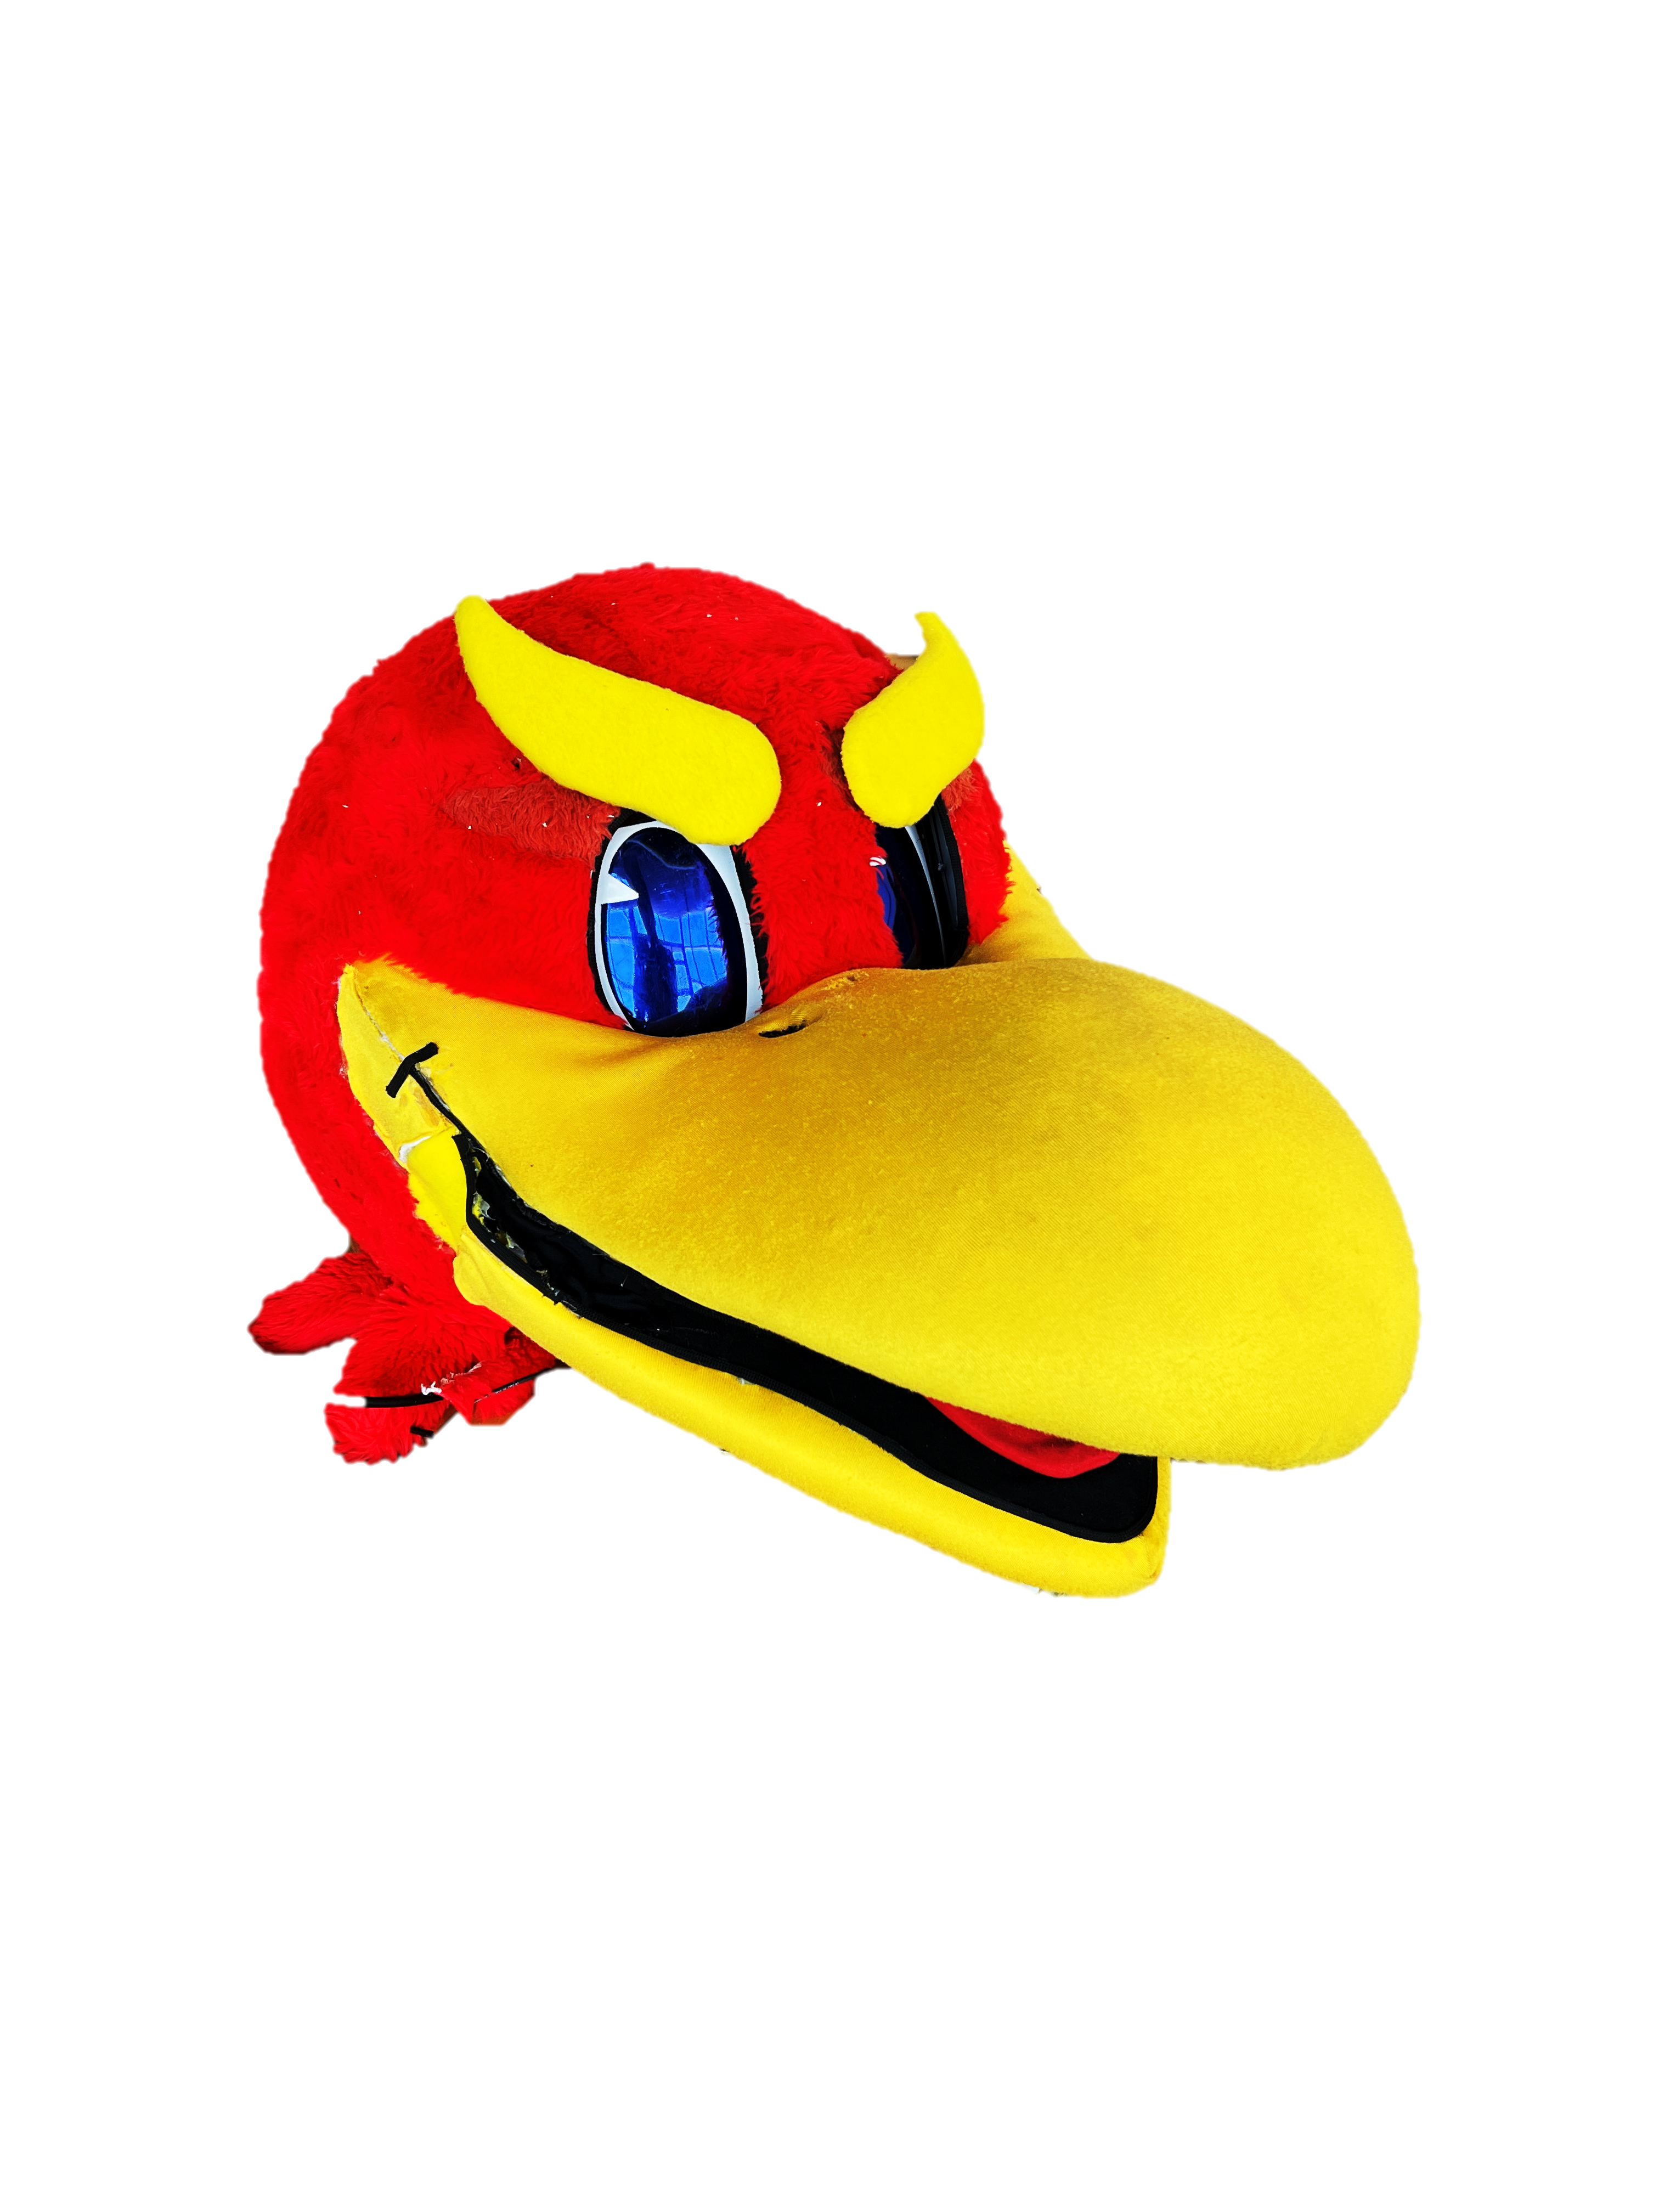
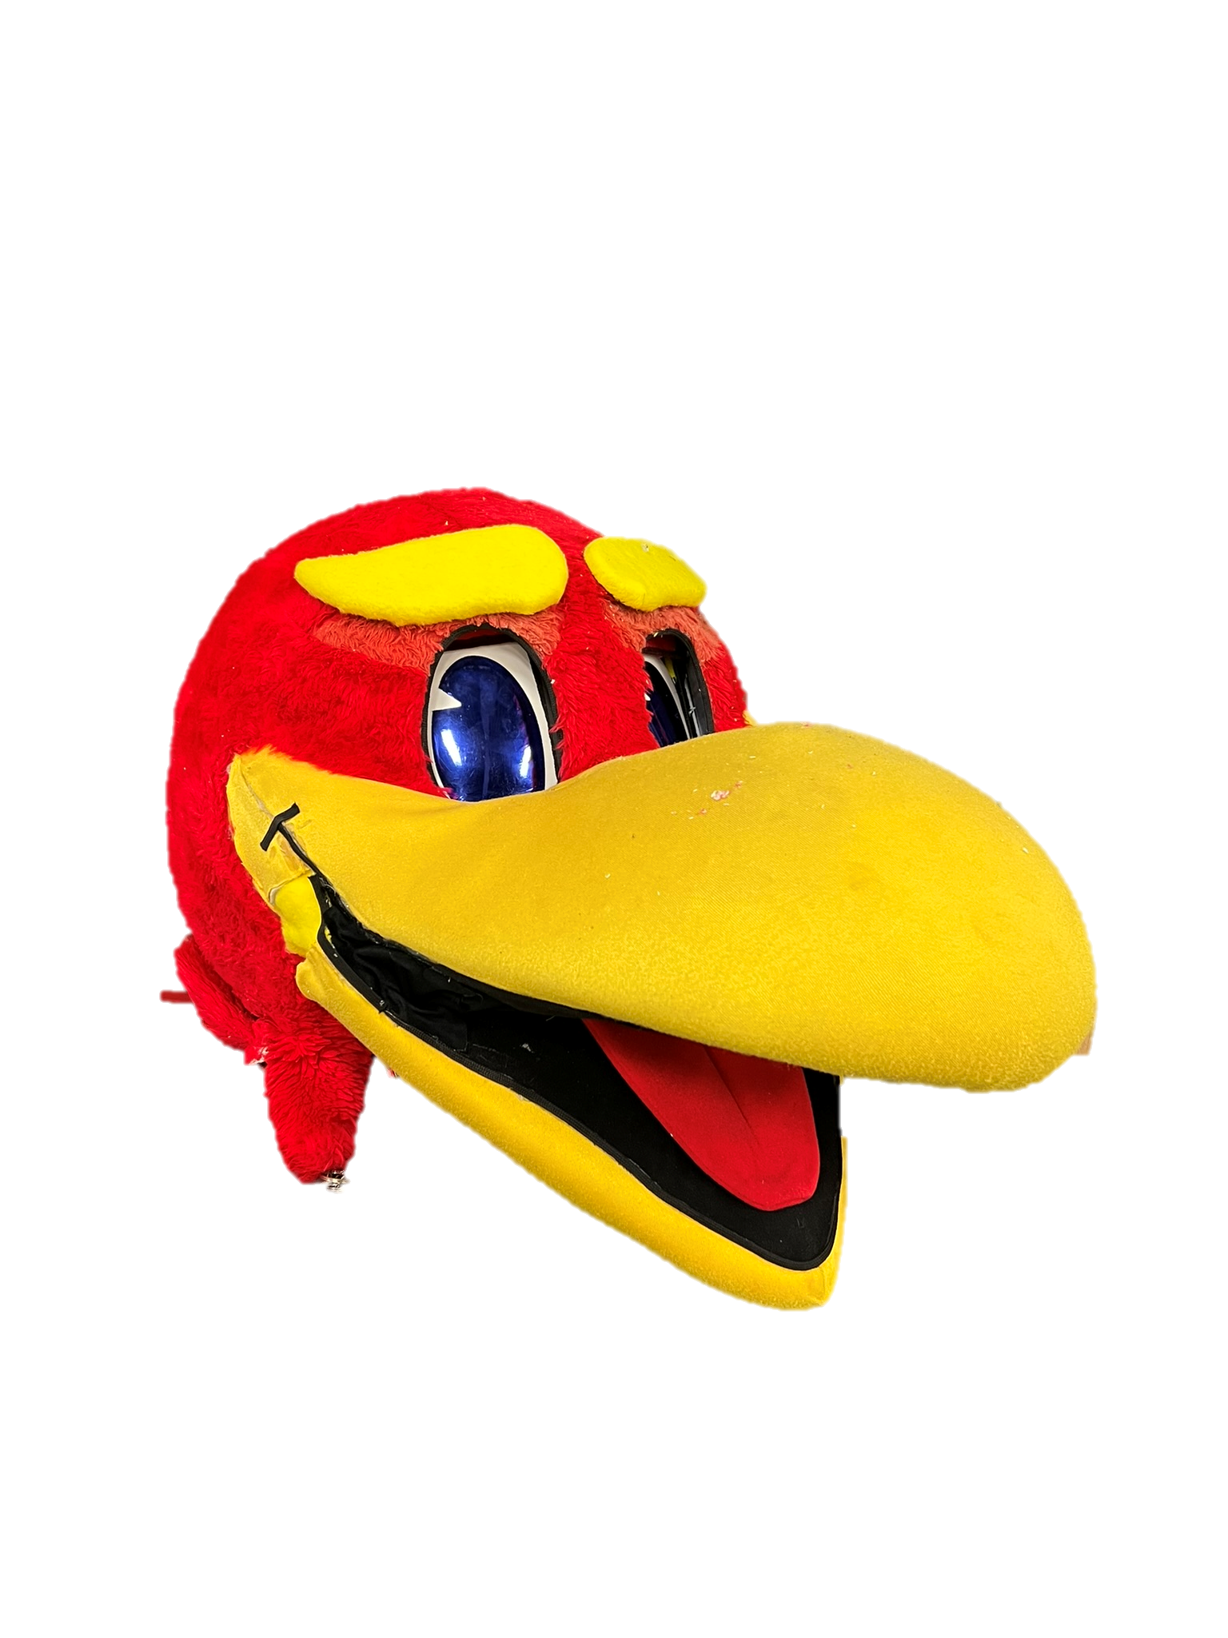
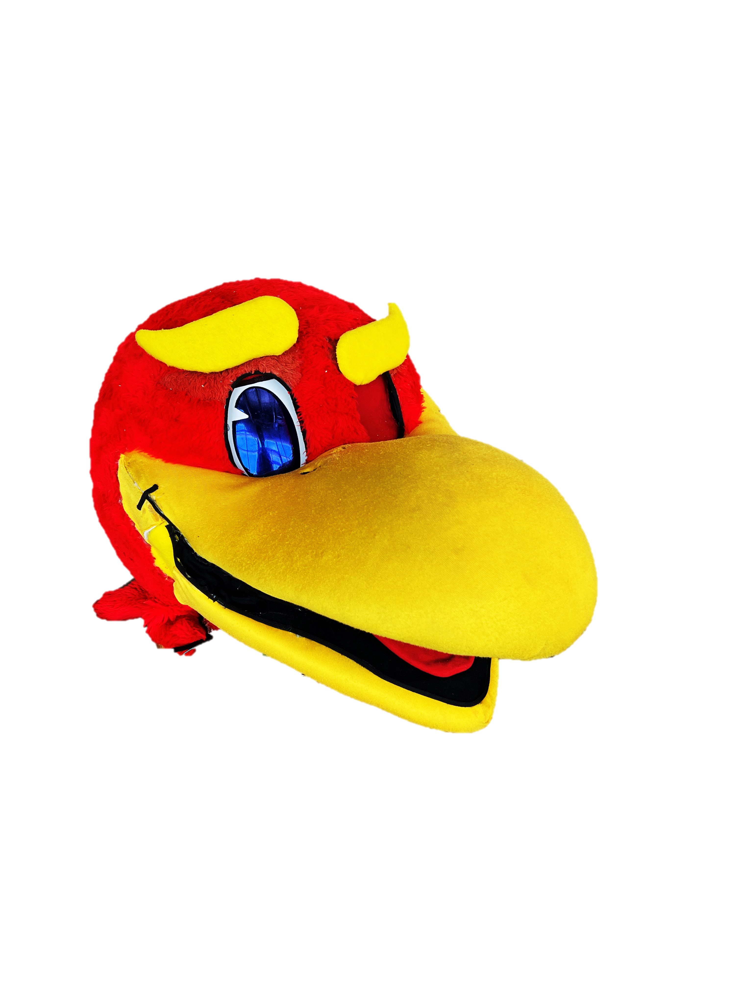
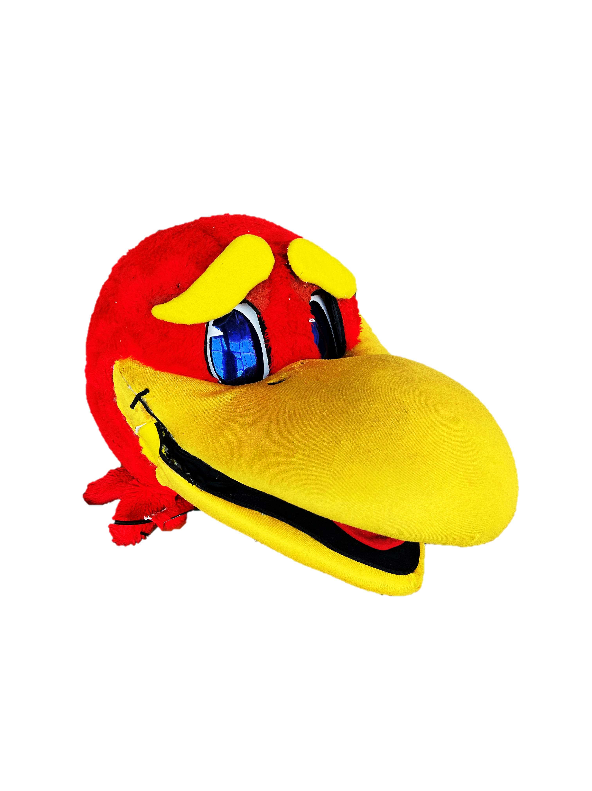
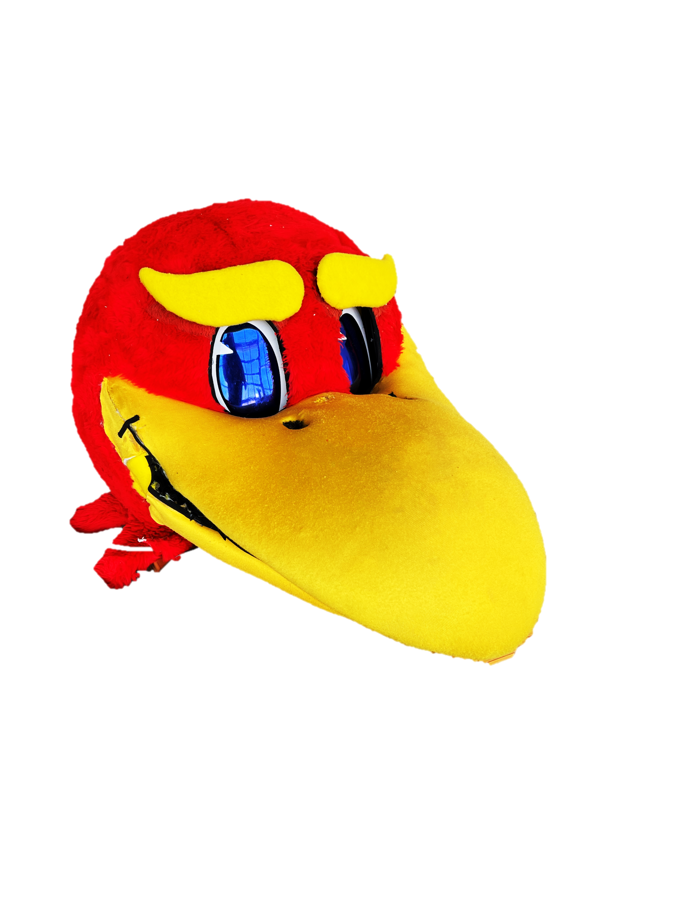
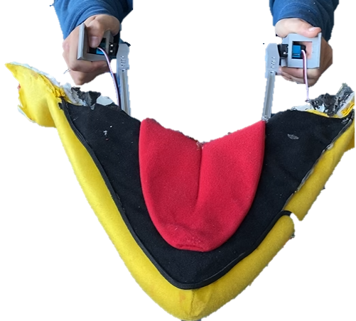
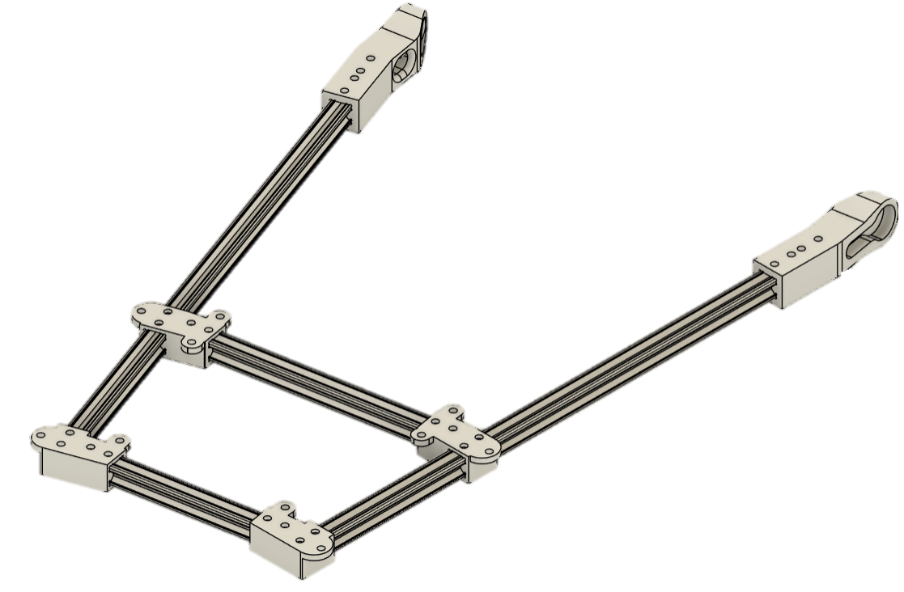
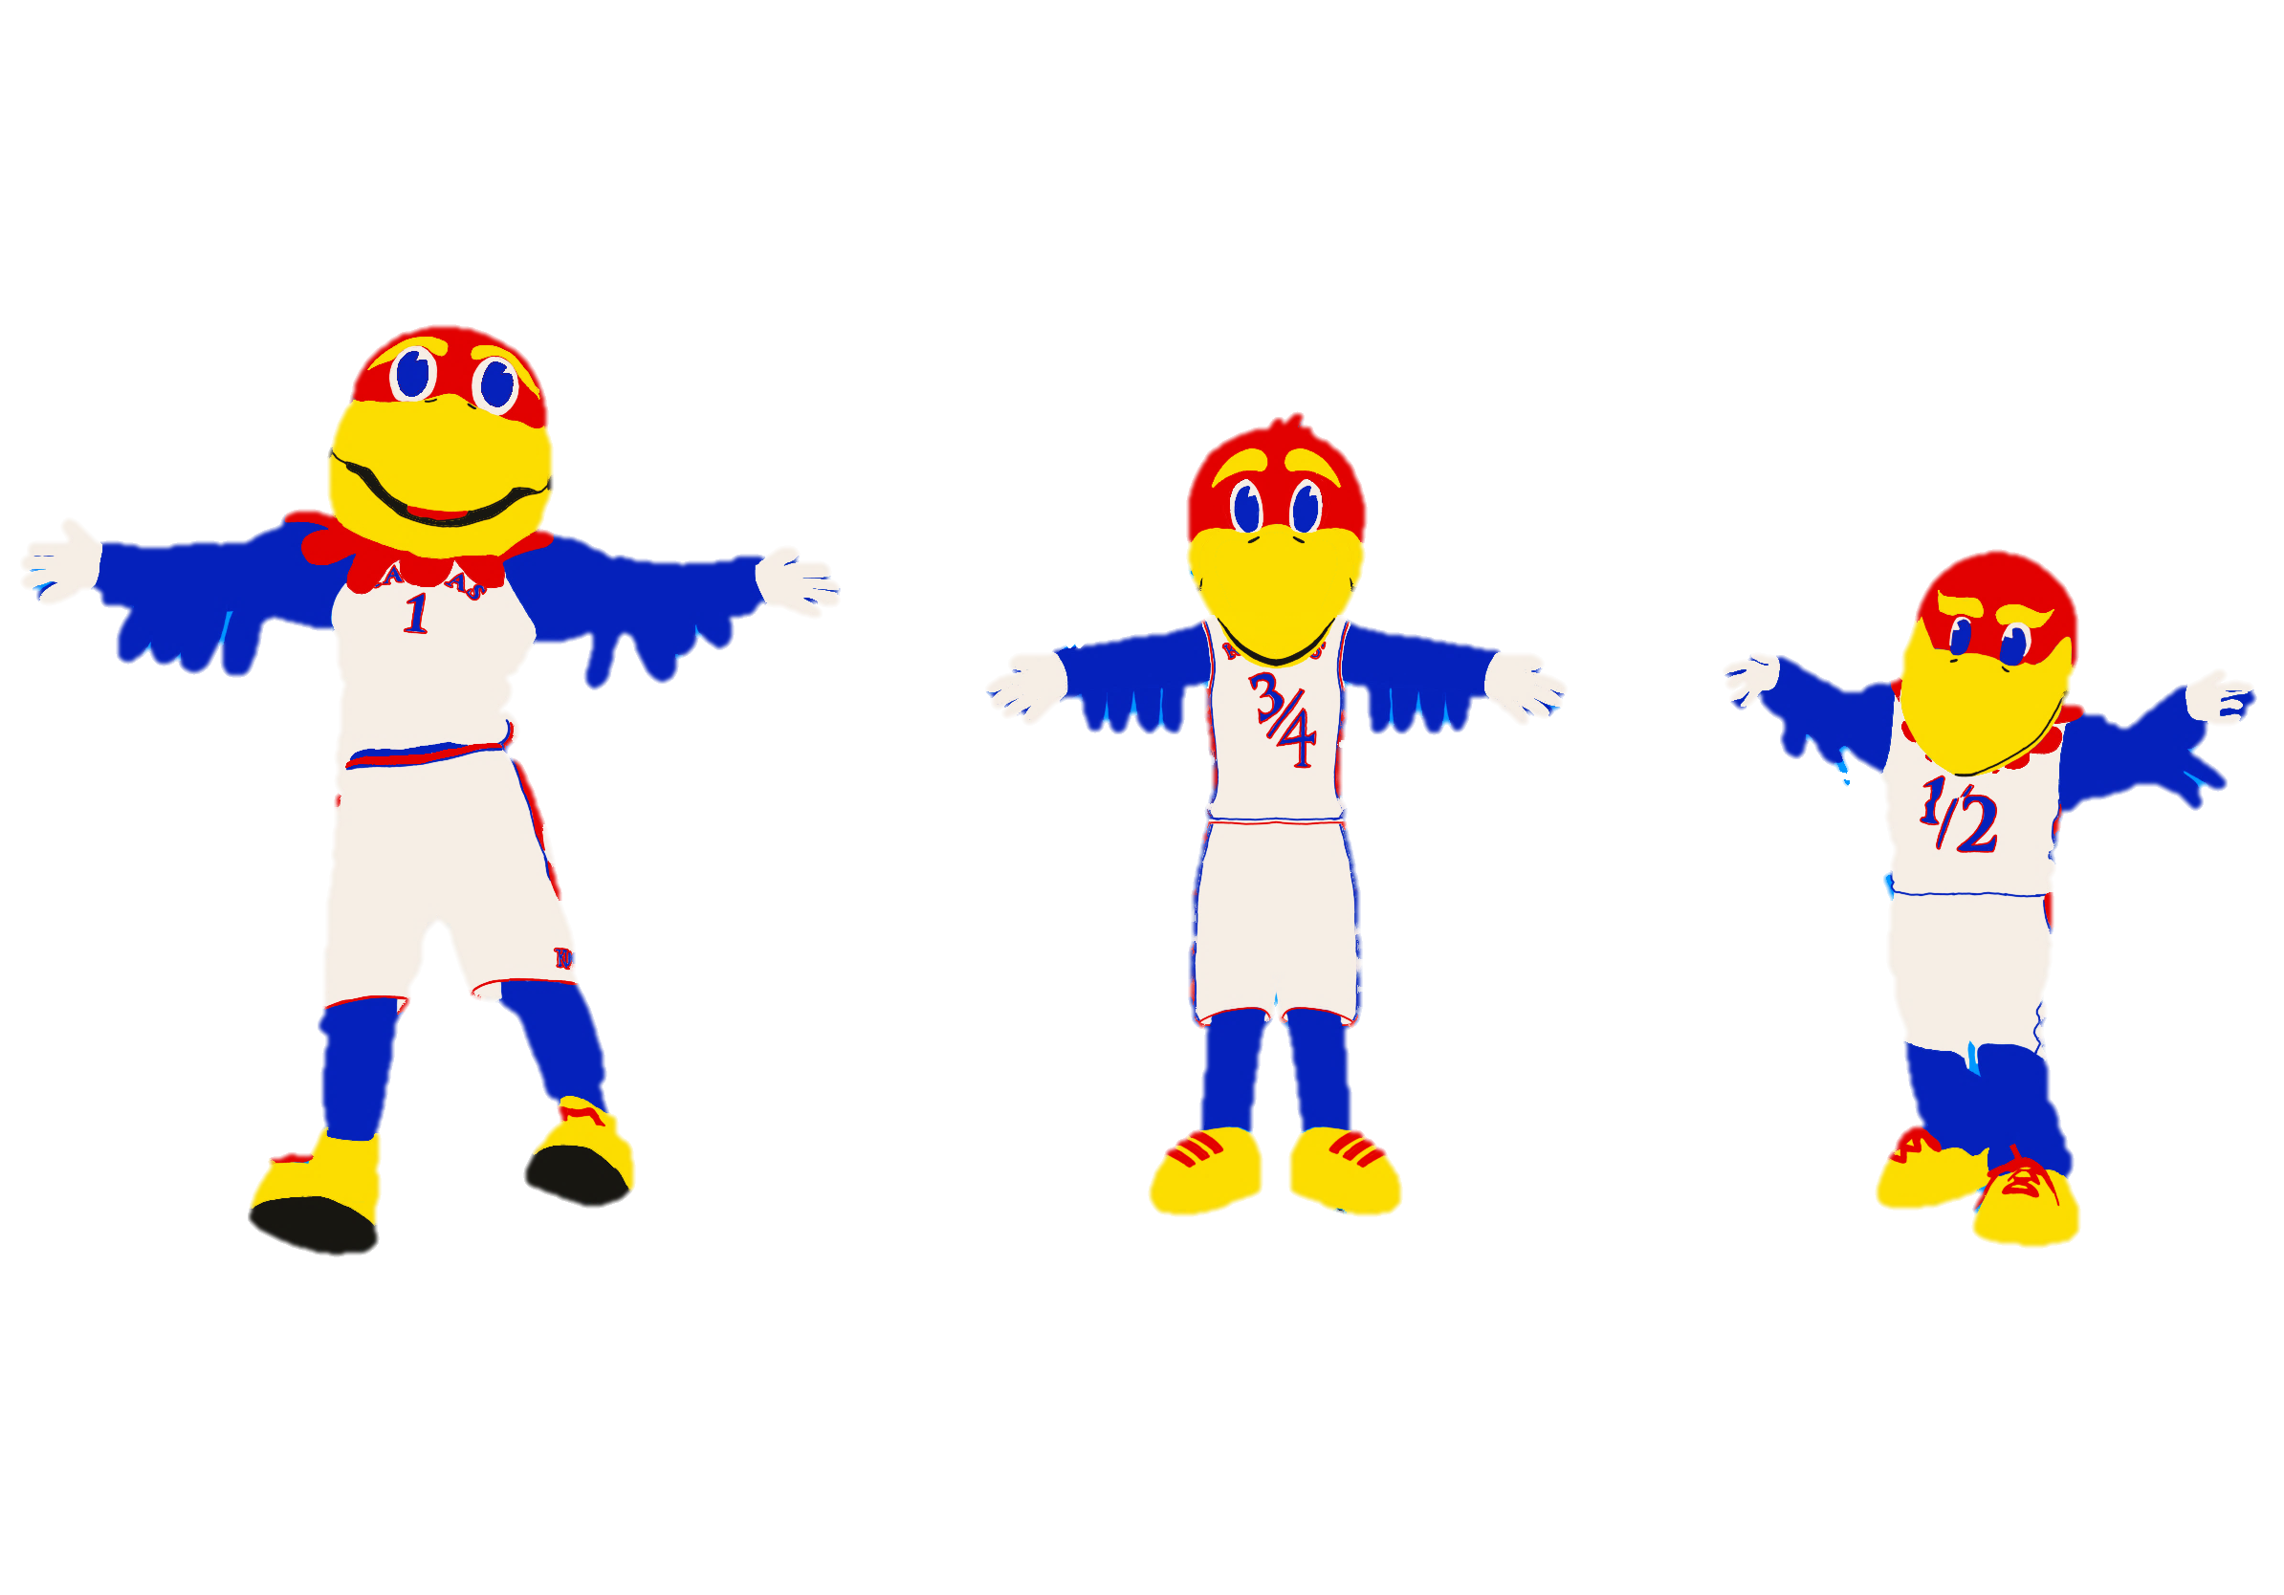
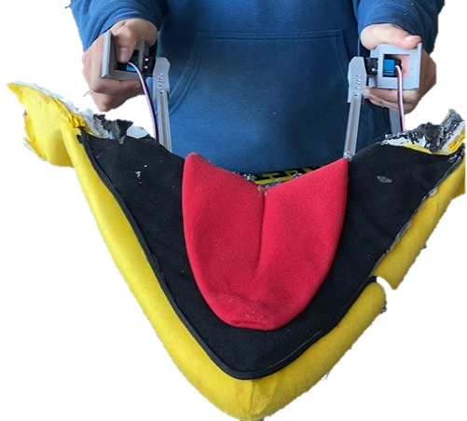
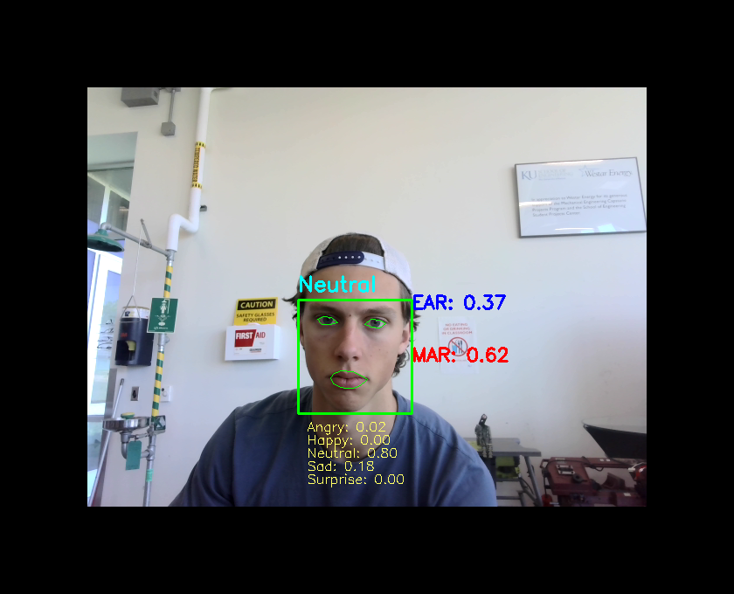

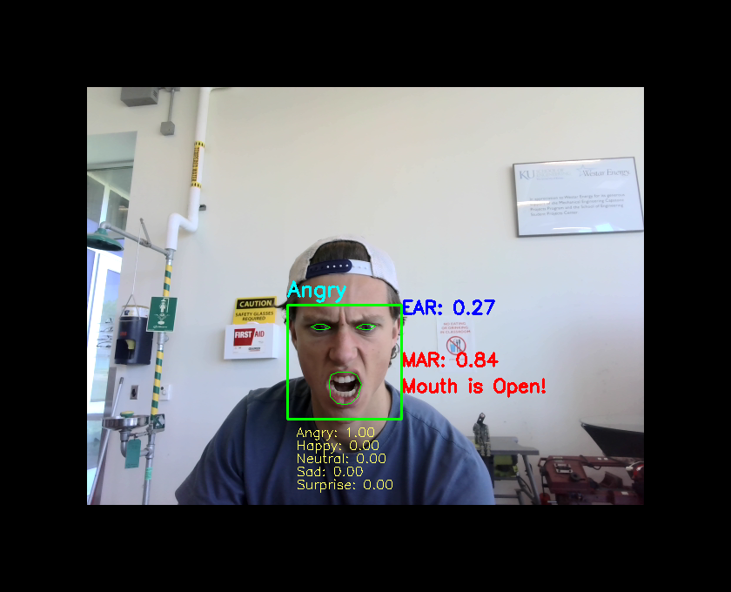

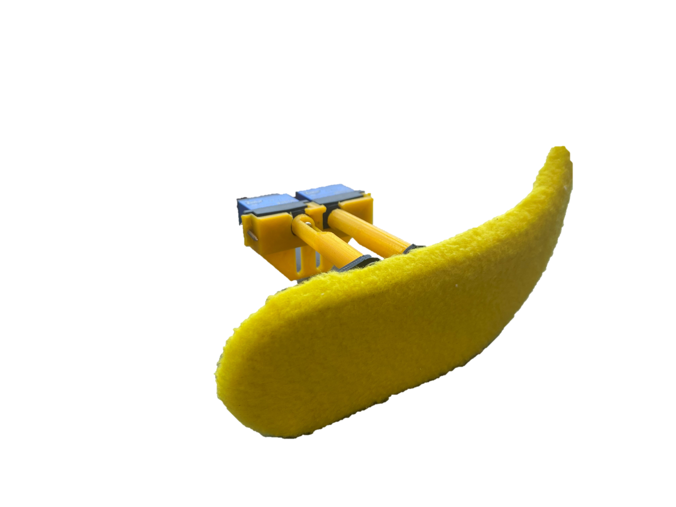
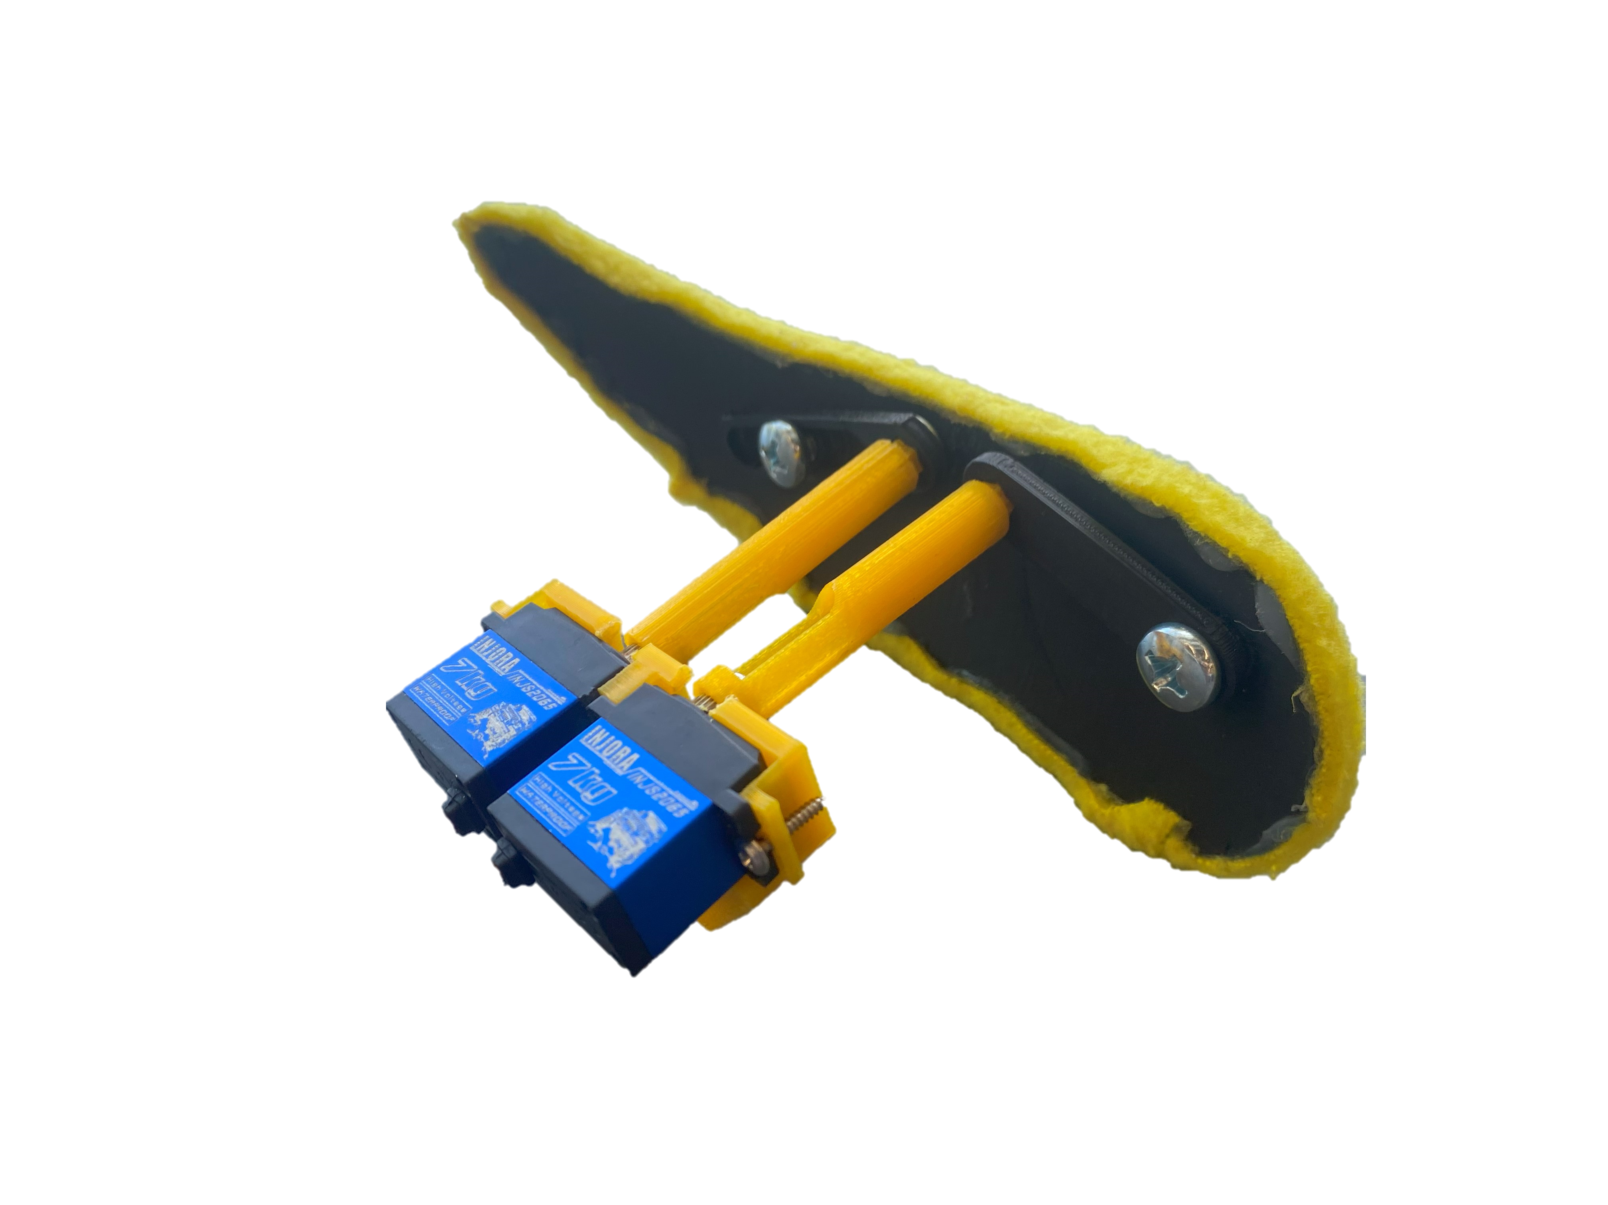
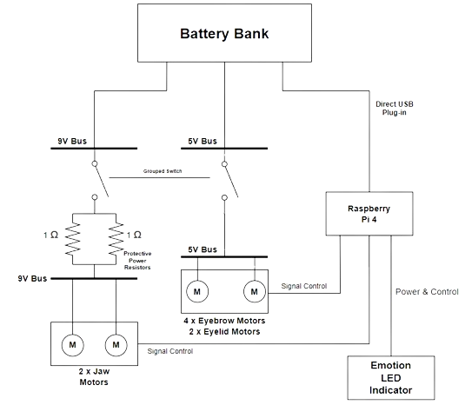
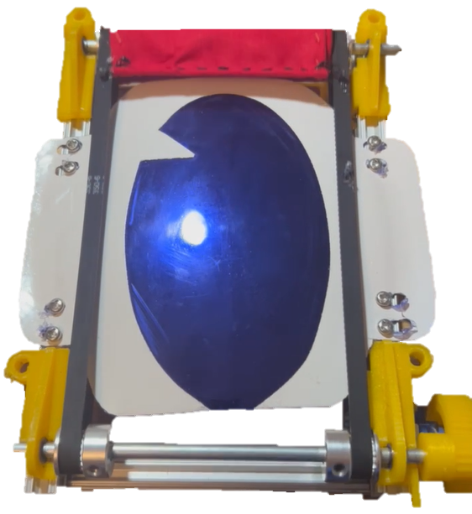
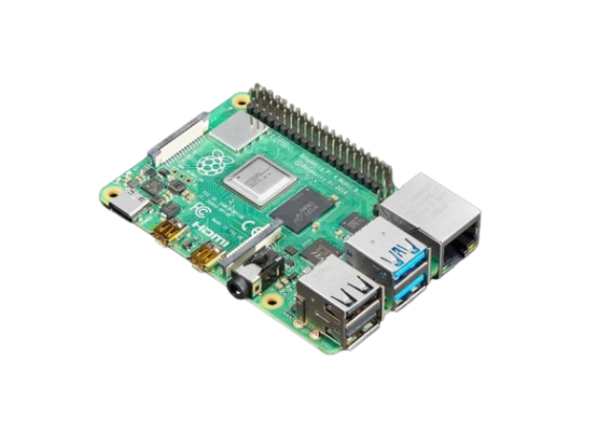
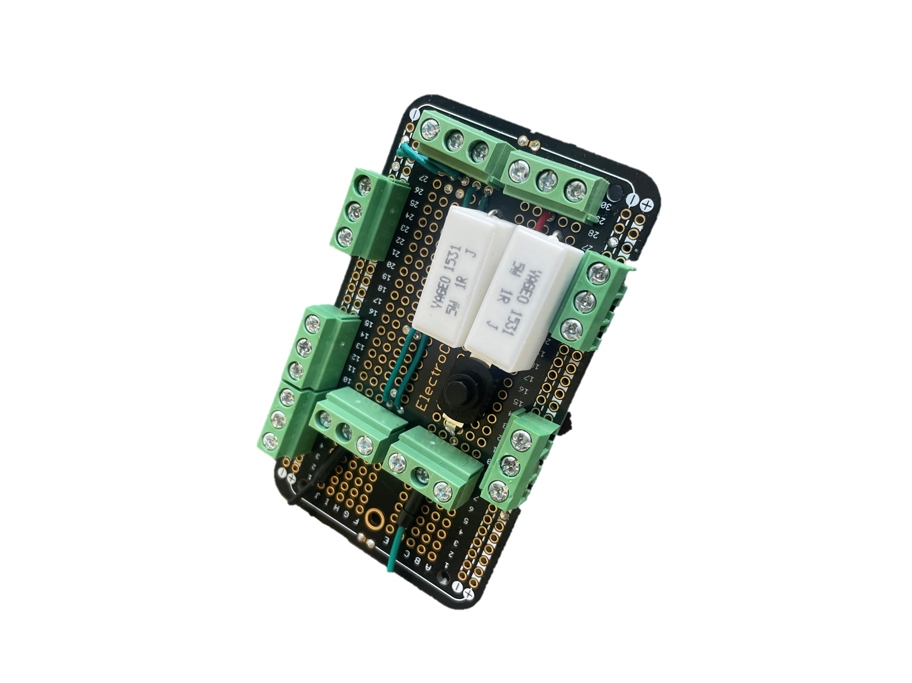
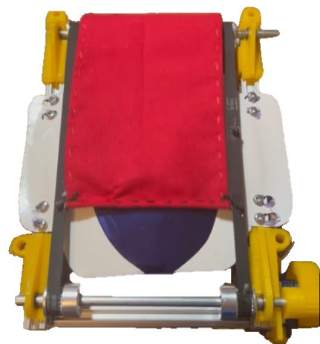
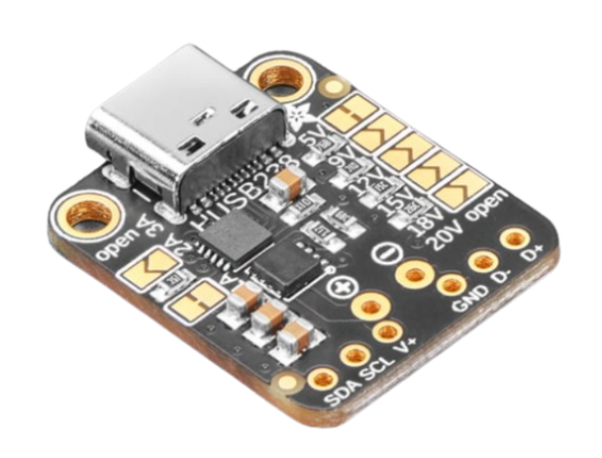
Junior Jay
ME: Luke Jansen, Scott Klein, Josh Ryan, Jake Eggleston
EECS: Bao Nguyen, Caleb Meyer, Josie Harding
Project Goal
Facial Detection Software
Mechanical Mechanisms
Develop a Jayhawk mascot animatronic with dynamic facial expressions for better live audience interaction, controlled by the wearer's facial movements.
Python script captures video frames, detects faces, predicts facial expression, and sends signal to adjust servo angles to mimic detected expression.
Custom machine learning model trained on the FER 2013 dataset for emotion recognition. Eye/mouth aspect ratio calculated to determine if open/closed.
Difficulties detecting face in dark, close-up environment inside the head—even with low-light, wide-angle camera.
Beak:
Goal: Open/close to simulate smile, shock.
Two high-torque servo motors running on 9V move lightweight Al frame fixed to beak.
Servo choice driven by requirement to counter beak weight of 1.5 lbs. with center of gravity centered 9 in. away (13.5 lbs·in).
Eyebrows:
Goal: Rotate to display nuanced emotions.
3-bar linkage consisting of fixed arm, slider arm, and eyebrow, uses servo rotation to pivot eyebrow.
Servos mounted neatly on eyelid frame inside head, with shafts protruding through forehead that spin links.
Eyelids:
Goal: Open/close to simulate blinking.
Custom thermoformed plastic coated with one-way mirror film ensures internal components cannot be seen from outside.
Belt-driven mechanism spins stitched-on fabric (eyelid) by continuous rotation servo.
Fabric spools at top so wearer’s vision is not obscured when in open position.
Limit switches tripped by belt send signal to shut off servo when eyelid is fully open/closed.
Electrical System
50,000mAh battery pack chosen for 2hr. lifetime, 5-20V output.
HUSB238 draws 5V, 9V from battery, custom power bus distributes 9V power to two beak servos, 5V to other six servos.
Power resistors protect system by limiting current flow.
Raspberry Pi runs facial detection software and sends signal to servos over GPIO pins.
Optional LED panel installed in head indicates detected emotion to wearer.
Raspberry Pi 4
Custom 5V/9V
Power Bus
HUSB238 Power
Delivery Breakout
Special thanks to KU Athletics for making this project possible by donating a retired Baby Jay head.

